Slide 1
No. 22

Slide 2

QUADRATIC EQUATIONS
Solving Quadratic Equations Using
Formula Method

Slide 3
3] Formula Method
General Form of a Quadratic Equation is
ax² + bx + c = 0
To use this formula
we should have value
of a, b & c
Formula to
find value of ‘x’

Slide 4


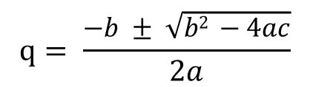

Solve the following by using formula method
i) 3q² = 2q + 8
$$q= \frac{−b ± \sqrt{b2 −4ac}}{2a}$$
Sol :
Standard
form
3q² = 2q + 8
To use formula
we should have value
of a, b & c
∴ 3q² – 2q – 8 = 0
On comparing with ax² + bx + c = 0,
we get,
∴ q =
or
q =
a = 3,
b = – 2
& c = – 8
aq² + bq + c = 0
(3)
b² – 4ac
= (– 2)² –
(– 8)
4
∴ q =
or
q =
= 4 + 96
= 100
2
or
q =
∴ q =
3q² – 2q – 8 = 0
∴ q =
-
(- 2)
$$±$$
$$\sqrt{100}$$
∴ q =
$$2(3)$$
∴ q =

Slide 5
No. 23

Slide 6
QUADRATIC EQUATIONS
Solving Quadratic Equations Using
Formula Method Contd…

Slide 7






Solve the following by using formula method
ii) 6m² – 4m = 3
Sol :
Standard
form
∴ m =
6m² – 4m – 3 = 0
On comparing with am² + bm + c = 0,
we get
∴ m =
Can we cancel
2 & 12 ?
a = 6,
b = – 4
, c = – 3
Can we cancel
4 & 12 ?
2
(2
b² – 4ac
(4)
(6)
∴ m =
$$±$$
$\sqrt{22 }$)
= ( -4)² –
(– 3)
= 16 + 72
$$12$$
= 88
∴ m =
Let us simplify it
∴ m =
∴ m =
or m =
-
(- 4)
$$±$$
$$\sqrt{88}$$
88 cannot be brought out of the root
∴ m =
$$2 (6)$$

Slide 8



homework
Solve the following by using formula method
iii) 3y² + 7y + 4 = 0
Sol :
3y² + 7y + 4 = 0
∴ y =
or
y =
On comparing with ay² + by + c = 0,
we get
∴ y =
or
y =
a = 3,
b = 7
, c = 4
(3)
b² - 4ac
= (7)² –
(4)
(4)
∴ y = – 1
or
y =
= 49 – 48
= 1
∴ y =
-
$$\sqrt{1}$$
7
$$±$$
∴ y =
$$2 (3)$$
∴ y =

Slide 9
No. 24

Slide 10
QUADRATIC EQUATIONS
Solving Quadratic Equations Using
Formula Method Contd…

Slide 11




Solve the following by using formula method
iv) 2x² + $\frac{x −1}{5}$= 0
∴ x =
Sol:
-
$$\sqrt{41}$$
1
$$±$$
Multiplying throughout by 5,we get
∴ x =
$$2 (10)$$
10x² + x – 1 = 0
On comparing with ax² + bx + c = 0,
we get
∴ x =
or
a = 10,
b = 1
, c = – 1
∴ x =
x =
b² - 4ac
(4)
(10)
( -1)
= (1)² -
= 1 + 40
= 41

Slide 12
No. 25

Slide 13
QUADRATIC EQUATIONS
Solving Quadratic Equations Using
Formula Method

Slide 14

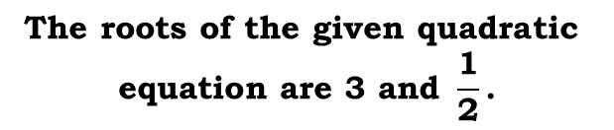



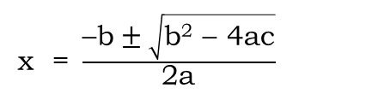






EX 4.3 2(I)
Q.) Find the roots of the following quadratic equations given, by applying the quadratic formula.
(i) 2x² – 7x + 3 = 0
Is it in a Standard form ?
x = $\frac{\text{7 }\text{±} \sqrt{\text{25}} }{\text{4}}$
∴
Sol:
2x² – 7x + 3 = 0
On comparing with ax² + bx + c = 0,
we get
x = $\frac{\text{7 }\text{±} \text{5}}{\text{4}}$
∴
Yes
a = 2,
b = – 7
, c = 3
x = $\frac{\text{7 }\text{+} \text{5}}{\text{4}}$
x = $\frac{\text{7 }\text{–} \text{5}}{\text{4}}$
∴
or
b² – 4ac
= (–7)² –
(4)
(2)
(3)
3
1
x = $\frac{\text{12}}{\text{4}}$
x = $\frac{\text{2}}{\text{4}}$
∴
or
= 49 – 24
2
= 25
or
x = $\frac{\text{1}}{\text{2}}$
∴
x = 3
x = $\frac{\text{–}\text{b} \text{± }\sqrt{\text{b}\text{2}\text{ – 4}\text{ac}}}{\text{2}\text{a}}$
∴
$$\text{The} \text{roots} \text{of} \text{the} \text{given} \text{quadratic}$$
$$\text{equation} \text{are}\text{ 3 }\text{and} \frac{\text{1}}{\text{2}}\text{.}$$
–
(– 7)
$$±$$
$$\sqrt{\text{25}}$$
∴
x =
$$\text{2 (2)}$$

Slide 15






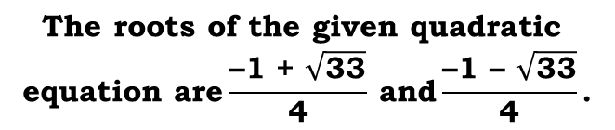
homework
EX 4.3 2(II)
Q.) Find the roots of the following quadratic equations given, by applying the quadratic formula.
(ii) 2x² + x – 4 = 0
Is it in a Standard form ?
x = $\frac{\text{–}\text{1 }\text{±} \sqrt{\text{33}} }{\text{4}}$
∴
Sol:
2x² – 1x – 4 = 0
x = $\frac{\text{–1 }\text{+ }\sqrt{\text{33}}}{\text{4}}$
x = $\frac{\text{–1 }\text{– }\sqrt{\text{33}}}{\text{4}}$
On comparing with ax² + bx + c = 0,
we get
or
∴
Yes
a = 2,
b = 1
, c = –4
∴
$$\text{The} \text{roots} \text{of} \text{the} \text{given} \text{quadratic}$$
$$\text{equation} \text{are}\frac{\text{–1 }\text{+ }\sqrt{\text{33}}}{\text{4}} \text{and}\frac{\text{–1 }\text{– }\sqrt{\text{33}}}{\text{4}}\text{.}$$
b² – 4ac
= (1)² –
(4)
(2)
(–4)
= 1 + 32
= 33
x = $\frac{\text{–}\text{b} \text{± }\sqrt{\text{b}\text{2}\text{ – 4}\text{ac}}}{\text{2}\text{a}}$
–
(1)
$$±$$
$$\sqrt{\text{33}}$$
∴
x =
$$\text{2 (2)}$$

Slide 16
No. 26

Slide 17
QUADRATIC EQUATIONS
Solving Quadratic Equations Using
Formula Method

Slide 18


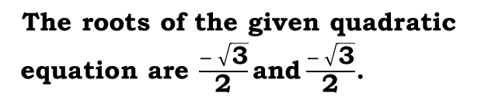














EX 4.3 2(III)
Q.) Find the roots of the following quadratic equations given, by applying the quadratic formula.
(iii) 4x² + 4$\sqrt{\text{3}}$x + 3 = 0
Is it in a Standard form ?
x = $\frac{\text{– }\text{4}\sqrt{\text{3}} \text{±} \text{0}}{\text{8}}$
Is it in a Standard form ?
∴
Sol:
4x² + 4$\sqrt{\text{3}}$x + 3 = 0
On comparing with ax² + bx + c = 0,
we get
x = $\frac{\text{– }\text{4}\sqrt{\text{3}}\text{ + }\text{0}}{\text{8}}$
or x = $\frac{\text{– }\text{4}\sqrt{\text{3}} \text{–} \text{0}}{\text{8}}$
∴
Yes
Yes
1
1
a = 4,
b = 4$\sqrt{\text{3}}$
, c = 3
x = $\frac{\text{– }\text{4}\sqrt{\text{3}} }{\text{8}}$
or x = $\frac{\text{– }\text{4}\sqrt{\text{3}} }{\text{8}}$
∴
b² – 4ac
= (4$\sqrt{\text{3}}$)² –
2
(4)
(4)
(3)
2
= (4)² × $(\sqrt{\text{3}}$ )²
=16 × 3
= 48
= 48 – 48
∴
x = $\frac{− \sqrt{\text{3}}}{\text{2}}$
or
x = $\frac{− \sqrt{\text{3}}}{\text{2}}$
= 0
x = $\frac{\text{–}\text{b} \text{± }\sqrt{\text{b}\text{2}\text{ – 4}\text{ac}}}{\text{2}\text{a}}$
∴
$$\text{The} \text{roots} \text{of} \text{the} \text{given} \text{quadratic}$$
$\text{equation} \text{are} \frac{− \sqrt{\text{3}}}{\text{2}}\text{and}\frac{− \sqrt{\text{3}}}{\text{2}}$.
(4$\sqrt{\text{3}}$)
$$±$$
$$\sqrt{\text{0}}$$
–
∴
x =
$$\text{2 (4)}$$

Slide 19

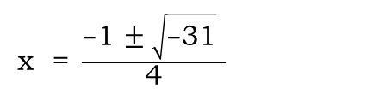

homework
EX 4.3 2(IV)
Q.) Find the roots of the following quadratic equations given, by applying the quadratic formula.
(iv) 2x² + x + 4 = 0
Is it in a Standard form ?
x = $\frac{\text{–}\text{1 }\text{±} \sqrt{\text{–}\text{31}} }{\text{4}}$
Sol:
2x² + 1x + 4 = 0
∴
On comparing with ax² + bx + c = 0,
we get
∴
b² – 4ac
<
0
Yes
∴
Roots of the equation 2x² + x + 4 = 0 are not real nos. i.e. roots do not exist.
a = 2,
b = 1
, c = 4
b² – 4ac
= (1)² –
(4)
(2)
(4)
= 1 – 32
Is –31 greater than 0 or less than 0 ?
∴
$$\text{The} \text{given} \text{quadratic} \text{equation}$$
$$\text{has} \text{no} \text{real} \text{roots}\text{.}$$
= –31
–31 is less than 0
x = $\frac{\text{–}\text{b} \text{± }\sqrt{\text{b}\text{2}\text{ – 4}\text{ac}}}{\text{2}\text{a}}$
–
(1)
$$±$$
$$\sqrt{\text{–31}}$$
∴
x =
$$\text{2 (2)}$$

Slide 20
No. 27

Slide 21
QUADRATIC EQUATIONS
Solving Quadratic Equations Using
Formula Method

Slide 22
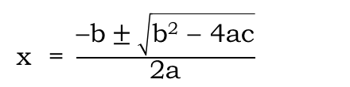





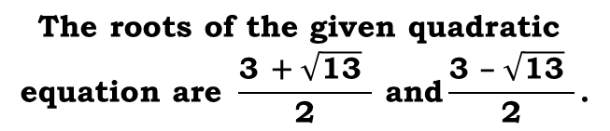



EX 4.3 3(I)
homework
Q.) Find the roots of the following equations:
(i) x – $\frac{\text{1}}{\text{x}}$= 3, x ≠ 0
–
(– 3)
$$±$$
$$\sqrt{\text{13}}$$
∴
x =
x – $\frac{\text{1}}{\text{x}}$= 3
$$\text{2 (1)}$$
Sol:
x = $\frac{\text{3 }\text{±} \sqrt{\text{13}} }{\text{2}}$
Multiplying throughout by x, we get
∴
∴
x² – 1 = 3x
x = $\frac{\text{3 }\text{+} \sqrt{\text{13}} }{\text{2}}$
x = $\frac{\text{3 }\text{–} \sqrt{\text{13}} }{\text{2}}$
Is it in a Standard form ?
or
∴
x² – 3x – 1 = 0
∴
1
On comparing with ax² + bx + c = 0,
we get
∴
$$\text{The} \text{roots} \text{of} \text{the} \text{given} \text{quadratic}$$
$$\text{equation} \text{are} \frac{\text{3 }\text{+ }\sqrt{\text{13}} }{\text{2}} \text{and}\frac{\text{3 }\text{– }\sqrt{\text{13}} }{\text{2}}\text{.}$$
Yes
a = 1,
b = – 3
, c = –1
b² – 4ac
= (–3)² –
(4)
(1)
(–1)
= 9 + 4
= 13
x = $\frac{\text{–}\text{b} \text{± }\sqrt{\text{b}\text{2}\text{ – 4}\text{ac}}}{\text{2}\text{a}}$

Slide 23



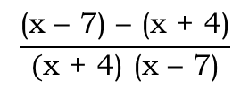


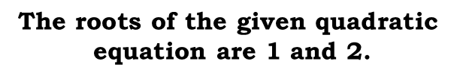







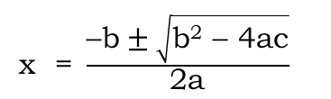
EX 4.3 3(II)
Q) Find the roots of the following equations:
(ii) $\frac{\text{1}}{\text{x} \text{+} \text{4}}$ – $\frac{\text{1}}{\text{x} \text{–} \text{7}}$= $\frac{\text{1}\text{1}}{\text{30}}$; x ≠ –4, 7
b² – 4ac
= (–3)² –
(4)
(1)
(2)
= 9 – 8
Sol:
$\frac{\text{1}}{\text{x} \text{+} \text{4}}$ – $\frac{\text{1}}{\text{x} \text{–} \text{7}}$= $\frac{\text{1}\text{1}}{\text{30}}$
= 1
x = $\frac{\text{–}\text{b} \text{± }\sqrt{\text{b}\text{2}\text{ – 4}\text{ac}}}{\text{2}\text{a}}$
$$\frac{\text{(}\text{x}\text{ – 7) – (}\text{x}\text{ + 4)}}{\text{(}\text{x} \text{+} \text{4}\text{) (}\text{x}\text{ – 7)}}$$
$$\frac{\text{11}}{\text{30}}$$
$$\text{=}$$
–
(– 3)
$$±$$
$$\sqrt{\text{1}}$$
$$\frac{\text{x}\text{ – 7 – }\text{x}\text{ − 4}}{\text{(}\text{x} \text{+} \text{4}\text{) (}\text{x}\text{ – 7)}}$$
$$\frac{\text{11}}{\text{30}}$$
∴
x =
∴
$$\text{=}$$
$$\text{2 (1)}$$
$$\frac{\text{– 11}}{\text{x}\text{2 }\text{– 3}\text{x}\text{ – 28}}$$
x = $\frac{\text{3 }\text{± }\sqrt{\text{1}} }{\text{2}}$
$$\frac{\text{11}}{\text{30}}$$
∴
∴
$$\text{=}$$
Dividing throughout by 11
x = $\frac{\text{3 }\text{+ }\text{1}}{\text{2}}$
x = $\frac{\text{3 }\text{– }\text{1}}{\text{2}}$
Is it in a Standard form ?
or
∴
$$\text{–330}$$
$$\text{=}$$
11x² – 33x – 308
∴
11x² – 33x – 308 + 330
∴
$$\text{=}$$
0
2
x = $\frac{\text{4}}{\text{2}}$
x = $\frac{\text{2}}{\text{2}}$
∴
or
1
∴
11x² – 33x + 22
$$\text{=}$$
0
Yes
∴
x² – 3x + 2
$$\text{=}$$
0
∴
x =$\text{2}$
or
x =$\text{1}$
1
On comparing with ax² + bx + c = 0,
we get
∴
$$\text{The} \text{roots} \text{of} \text{the} \text{given} \text{quadratic}$$
$$\text{equation} \text{are}\text{ 1 }\text{and}\text{ 2.}$$
a = 1,
b = – 3
, c = 2

Slide 24
No. 28

Slide 25
QUADRATIC EQUATIONS
. Understanding nature of roots of a
Quadratic Equation

Slide 26












Solve the following by using formula method
v) 3y² + 9y + 4 = 0
vi) y² + 6y + 9 = 0
vii) 2x² + 5$\sqrt{3}x +16 = 0$
Is it in a Standard form ?
Is it in a Standard form ?
Is it in a Standard form ?
Sol:
3y² + 9y + 4 = 0
Sol:
y² + 6y + 9 = 0
1
Sol:
2x² + 5$\sqrt{3}x +16 = 0$
On comparing with
ax² + bx + c = 0, we get
On comparing with
ax² + bx+ c = 0, we get
On comparing with
ax² + bx + c = 0, we get
a = 1,
b = 6
Yes
Yes
a = 3,
b = 9
, c = 4
Yes
, c = 9
a = 2,
b = 5$\sqrt{3}$
, c = 16
b² - 4ac
b² - 4ac
= (6)² – 4 (1) (9)
= (9)² – 4 (3) (4)
b² - 4ac
= 81 - 48
= 36 - 36
= 0
= 75 - 128
= 33
Is 33 greater than 0 ?
Here, b²-4ac = 0
∆
b² – 4ac
= 0
= - 53
∆
∴ y =
b² – 4ac
> 0
∴ y =
Hence roots of the quadratic
equation are real and equal.
∆
-53 is less than 0
b² – 4ac
< 0
-
Is -53 greater than 0 or less than 0 ?
∴ x =
6
Hence roots of the quadratic
equation are real and unequal.
$$±$$
$$\sqrt{0}$$
-
$$\sqrt{33}$$
∴ y =
Yes
9
∴ y =
$$±$$
$$2 (1)$$
Hence roots of the quadratic
equation are not real
-
5$\sqrt{3}$
$$2 (3)$$
$$±$$
$$\sqrt{−53}$$
∴ y =
∴ x =
∴ y =
$$2 (2)$$
∴ y =
y =
or
or
∴ y =
y =
∴ y = - 3 or y = - 3

Slide 27
No. 29

Slide 28
QUADRATIC EQUATIONS
Finding the nature of roots and finding roots if they are real

Slide 29









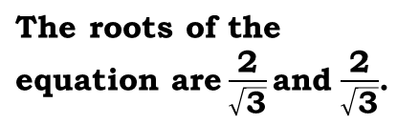
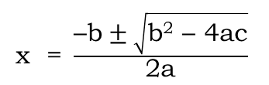








Q) Find the nature of roots of the following quadratic equations.
If the real roots exist, find them.
ii) 3x² – 4$\sqrt{\text{3}}$ x + 4 = 0
Is it in a Standard form ?
Sol:
3x² – 4$\sqrt{\text{3}}$ x + 4 = 0
What we have to find in this sum.
Means we have to find the value of b² – 4ac
x = $\frac{\text{4}\sqrt{\text{3}}\text{ + }\text{0}}{\text{6}}$
or x = $\frac{ \text{4}\sqrt{\text{3}} \text{–} \text{0}}{\text{6}}$
On comparing with ax² + bx+ c = 0, we get;
∴
So we need to find the values of a, b and c
a = 3,
b = – 4$\sqrt{\text{3}}$,
c = 4
2
For that, equation should be in the standard form
2
Yes
x = $\frac{ \text{4}\sqrt{\text{3}} }{\text{6}}$
or x = $\frac{ \text{4}\sqrt{\text{3}} }{\text{6}}$
b² – 4ac
= (– 4$\sqrt{\text{3}}$)² – 4 (3) (4)
∴
Is it in a standard form ?
= (4)² × $(\sqrt{\text{3}}$ )²
=16 × 3
= 48
= 16 × 3 – 48
3
3
= 48 – 48
∴
x = $\frac{\text{2}\sqrt{\text{3}}}{\text{3}}$
or
x = $\frac{\text{2}\sqrt{\text{3}}}{\text{3}}$
= 0
b² – 4ac
= 0
∴
x = $\frac{\text{2}}{\sqrt{\text{3}}}$
or
x = $\frac{\text{2}}{\sqrt{\text{3}}}$
∴
The two roots are real and equal
x = $\frac{\text{–}\text{b} \text{± }\sqrt{\text{b}\text{2}\text{ – 4}\text{ac}}}{\text{2}\text{a}}$
∴
$\text{The} \text{roots} \text{of} \text{the} \text{equation} \text{are}\frac{\text{2}}{\sqrt{\text{3}}}\text{a}\text{nd}$ $\frac{\text{2}}{\sqrt{\text{3}}}$.
(– 4$\sqrt{\text{3}}$)
$$±$$
$$\text{0}$$
–
=
$$\text{2 }\text{×}\text{ 3}$$

Slide 30
No. 30

Slide 31
QUADRATIC EQUATIONS
Discriminant
Sums Based on Nature Of Roots

Slide 32
DISCRIMINANT
If
b² - 4ac
>
0
Two distinct real roots
Discriminant is the value of b² – 4ac
If
b² - 4ac
=
0
Two equal real roots
If
b² - 4ac
<
0
No real roots

Slide 33
EX 4.4 1(I)
Find the nature of roots of the following quadratic equations.
If the real roots exist, find them.
i) 2x² – 3x + 5 = 0
What we have to find in this sum.
Sol:
2x² – 3x + 5 = 0
Means we have to find the value of b² – 4ac
On comparing with ax² + bx+ c = 0, we get;
a = 2,
b = - 3,
c = 5
For that equation should be in the standard form
So we need to find the values of a, b and c
b² - 4ac
Is it in a standard form ?
= (-3)² – 4 (2) (5)
= 9 – 40
= – 31
Yes
b² - 4ac
< 0
Hence roots of the quadratic
equation are not real

Slide 34







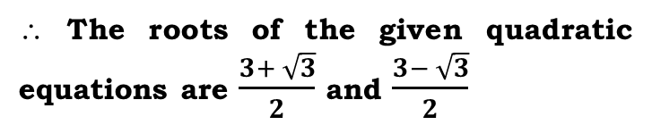
EX 4.4 1(III)
Find the nature of roots of the following quadratic equations.
If the real roots exist, find them.
ii) 2x² – 6x + 3 = 0
$=\frac{–(−6) ± \sqrt{12}}{2(2)}$
2x² – 6x + 3 = 0
On comparing with ax² + bx+ c = 0, we get;
$=\frac{6 ± 2\sqrt{3}}{4}$
a = 2,
b = -6,
c = 3
b² - 4ac
Is it in a standard form ?
$=\frac{2 (3± \sqrt{3}) }{4}$
= (-6)² – 4 (2) (3)
= 36 – 24
$=\frac{3± \sqrt{3}}{2}$
= 12
Yes
b² - 4ac
> 0
$∴ x =\frac{3+ \sqrt{3}}{2}$
or$x =\frac{3 − \sqrt{3}}{2}$
Hence roots of the quadratic
equation are real and distinct.
∴ The roots of the given quadratic equations are $\frac{3+ \sqrt{3}}{2}$ and $\frac{3− \sqrt{3}}{2}$
$\frac{–b ± \sqrt{b^{2}−4ac}}{2a}$
∴ x =

Slide 35
TThank Youk You

